Slide 1
Creating Employee performance scorecard in Excel
PRESENTED BY: T R TRISHA
REGISTER NO: 122201961
asunm135122/cp/95
DEPARTMENT: B.COM(CORPORATE SECRETARYSHIP)
COLLEGE: CHEVALIER T THOMAS ELIZABETH
COLLEGE FOR WOMEN

Slide 2
PROJECT TITLE
Creating an Employee Performance Analysis in Excel

Slide 3


AGENDA
Problem Statement
Project Overview
End Users
Our Solution and Proposition
Dataset Description
Modelling Approach
Results and Discussion
Conclusion
3/21/2024 Annual Review

Slide 4

PROBLEM STATEMENT
To Develop an Excel-based Employee Performance Analysis to systematically evaluate and monitor employee performance across multiple criteria.
The scorecard should facilitate performance reviews, goal setting, and improvement tracking.

Slide 5

PROJECT OVERVIEW
.
An employee performance analysis in Excel is a tool used to systematically evaluate and track an employee's performance against predefined objectives and key performance indicators (KPIs).
It typically includes various metrics such as productivity, quality of work, punctuality, teamwork, and any other relevant criteria.

Slide 6

WHO ARE THE END USERS?
HR PROFESSIONALS
MANAGER
SUPERVISORS
EXECUTIVE
EMPLOYEES

Slide 7

OUR SOLUTION AND ITS VALUE PROPOSITION
CONDITIONAL FORMATING – EDITING BLANKS MARK
FILTERING – REMOVING MISSING VALUES
USING PIVOT TABLE – SUMMARY OF EMPLOYEE PERFORMANCES
FORMULA - =IFS FORMULA
USING SLICER – EMPLOYEE TYPE
GRAPHS = FINAL REPORT

Slide 8
Dataset Description
Employee dataset
26 features
9 features used
EMP ID
Name-text
Start date-number
End date-number
Rating-number
Performance-text
gender-female , male
Business unit- text
Business type- text

Slide 9

THE "WOW" IN OUR SOLUTION
The dataset for the Performance Management Dashboard is designed to capture and analyze key aspects of employee performance. It consists of multiple data fields that provide a comprehensive view of each employee's performance metrics. Here's a detailed description of the dataset structure and the significance of each data field:
Dynamic Data Summarization
Interactive Data Exploration
Customizable Views and Reports
Trend Analysis and Comparison
Visual Data Representation
Efficient Data Management
Advanced Filtering and Grouping
3/21/2024 Annual Review

Slide 10
MODELLING
STEP 1 : DATASET FEATURE SELECTION – EMPLOYEE ID , FIRST NAME,BUSINESS UNIT, GENDER,EXPIRE DATE, PERFORMANCES SCORE, EMPLOYEE TYPE.
STEP 2 : DATA CLEANING : PERFORMANCE CATEGORY COMPUTATION USING FORMULA : =IFS(Z8>=5,”VERY HIGH”,Z8>=4,”HIGH”.Z8>=3.”MED”.”TRUE,”LOW”)
STEP 3 : PERFORMANCES SUMMARY PIVOT TABLE ( PERFORMANCE SCORE ROWS , PERFOMANCE LEVEL)

Slide 11
MODELLING
STEP 4 : SLICER FOR EMPLOYEE TYPE
STEP 5 : GRAPH – COLUMN EMPLOYEE RATING
STEP 6 : EDITING FOR + ICON IN CHART TO CUSTOMIZES
AXIS TITLE
ASES
CHART TITLE
GRIDLINES

Slide 12
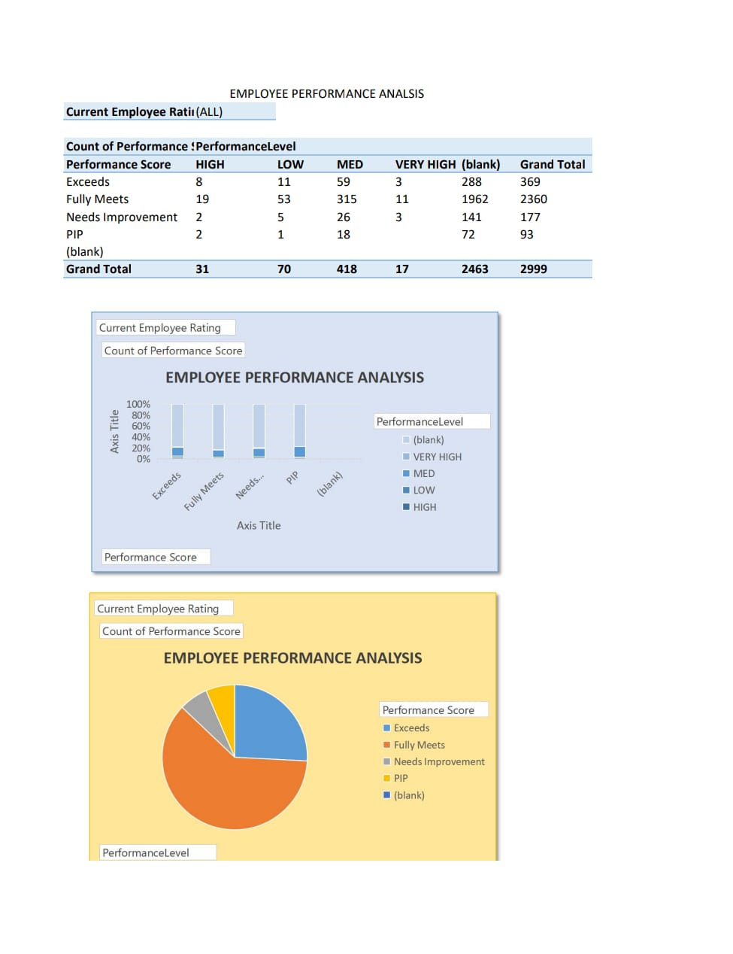
RESULTS

Slide 13
Conclusion
The Employee Performance Analysis effectively tracks and evaluates key performance indicators (KPIs) across various department .
Insights from the scorecard highlight areas of strength and opportunities for improvement, enabling more targeted management strategies

